Slide 1
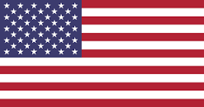
American Flags
United States of America

Slide 2
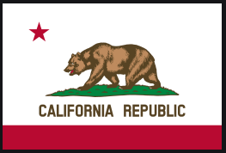
Can you guess the flag?
California State

Slide 3
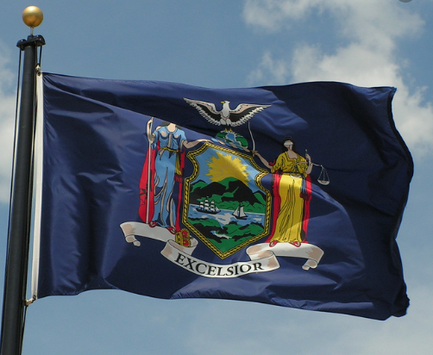
Can you guess the flag?
New York State

Slide 4
Can you guess the flag?
Hawaii

Slide 5
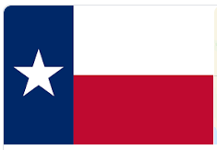
Can you guess the flag?
Texas

Slide 6
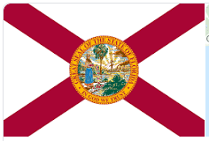
Can you guess the flag?
Florida

Slide 7
If you won the presidential election, what would you flag look like and why?

