Slide 1
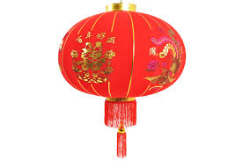
Chinese Lanterns

Slide 2
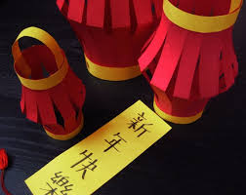
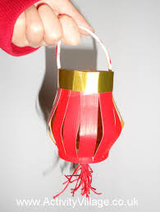
Things to think about…
Colours
Different style lanterns
What materials will you need?
How will you make it so you can hang your lantern?
https://www.youtube.com/watch?v=CeZKYGmuZn0

