Slide 1
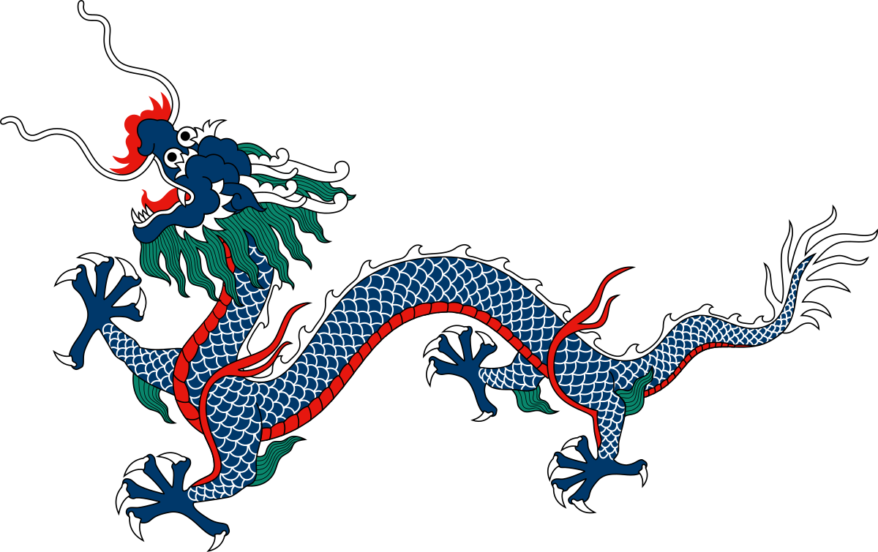
Chinese Dragons

Slide 2
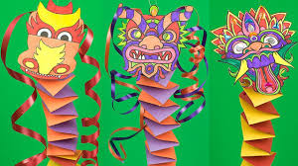
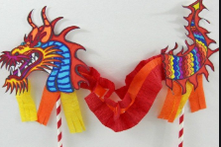
Things to think about…
Colours
Different dragon heads
What materials will you need?
How will you make it move?
https://www.youtube.com/watch?v=zaJG1mXPiEs

